Slide 1

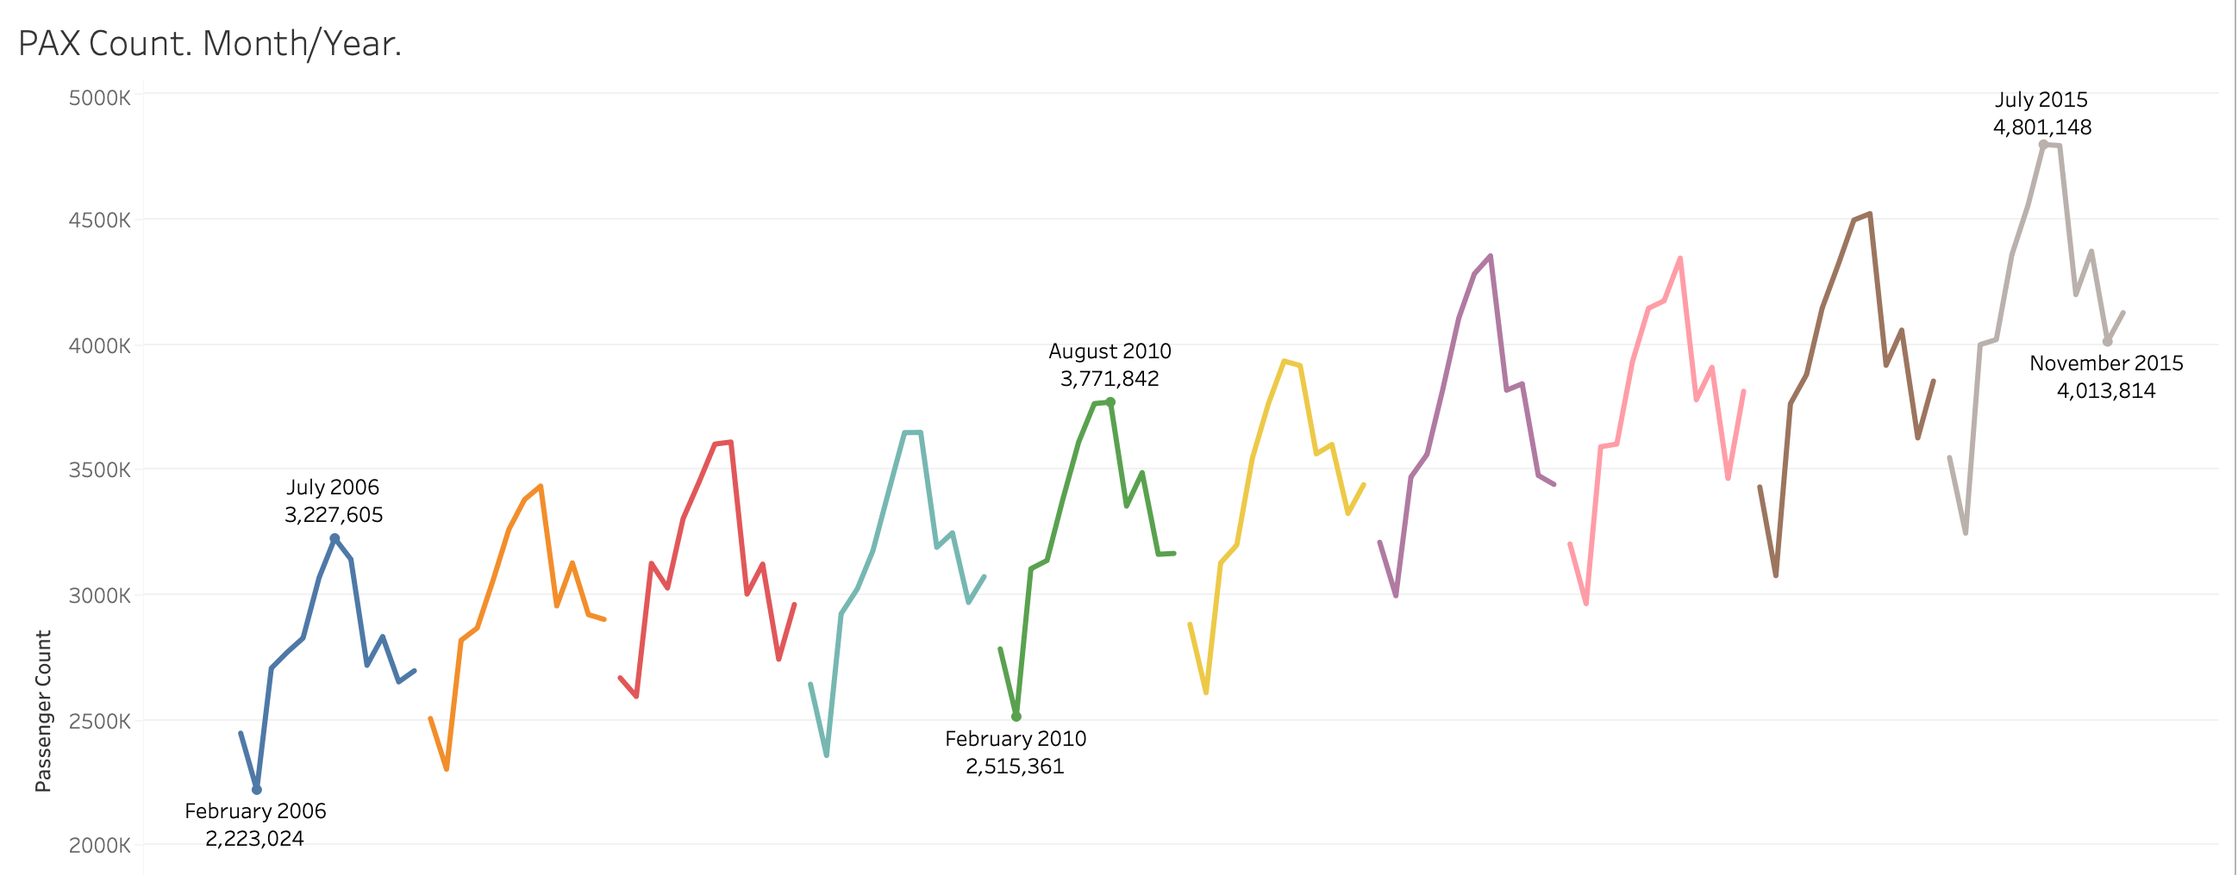
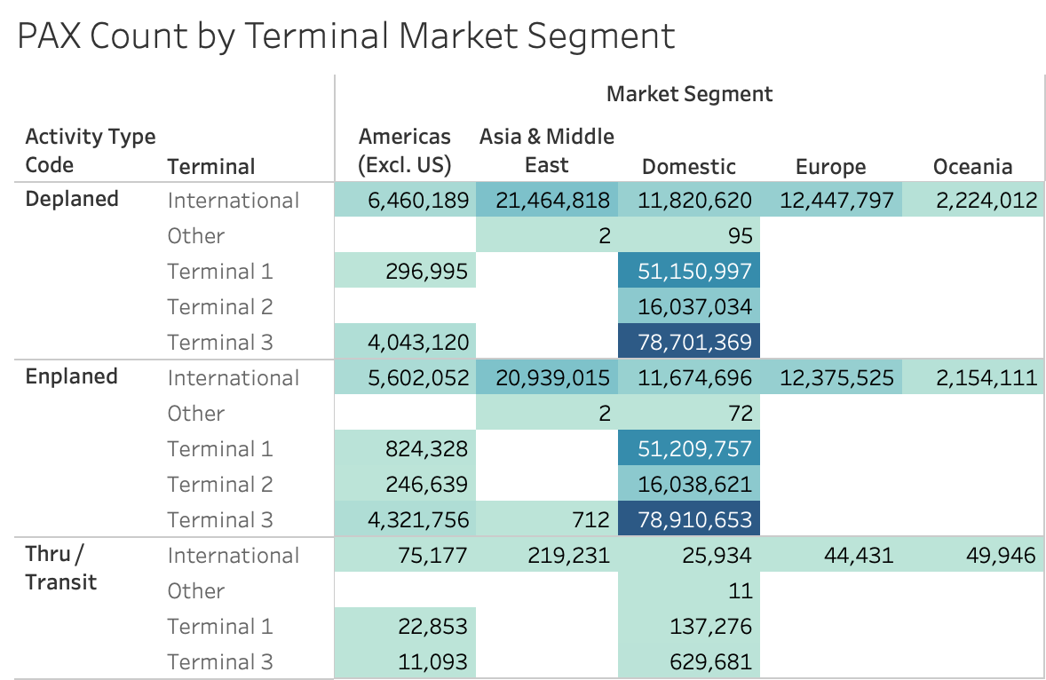
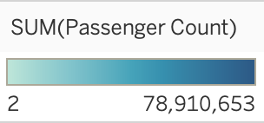
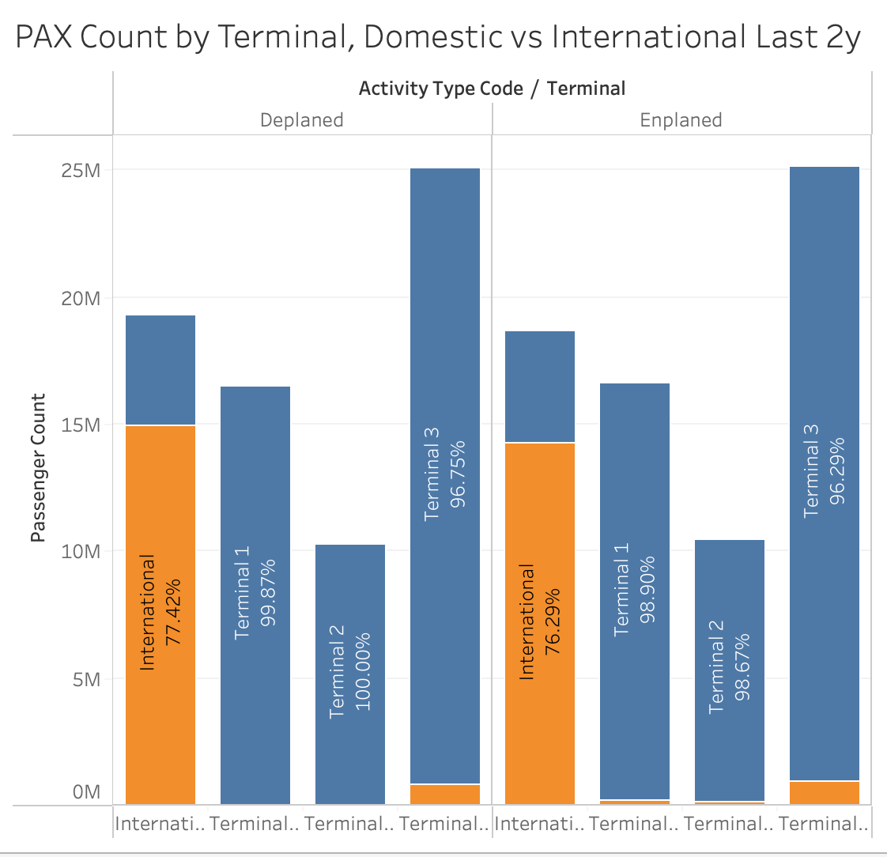
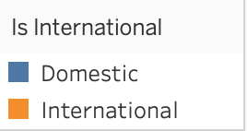
Strategic Insights on SFO Passenger Traffic:
A Data-Driven Analysis
Rafael Da Rosa Barp
Level 7 Diploma in Data Analytics for Business
Introduction
and the US East Coast. By analysing the market segment distribution, it is clear that while domestic flights are the backbone of the operation, increasing international transit partnerships could significantly boost profitability. Strengthening ties with transpacific carriers would not only increase passenger numbers but also maximize Duty-Free profits, positioning SFO as a vital bridge in global aviation.
This study analyses the “Airline Traffic Passenger Statistics” from SFO International Airport (2006-2015), bridging the gap between raw data and professional aviation experience. By cleaning and standardizing the dataset in Excel and visualizing it in Tableau, we identified critical trends for future airport management.
Methods
Fig. 1 Time Series - Growth of Passengers over the Years.
This study employed a structured data science workflow to ensure the reliability of the strategic insights. The original "Airline Traffic Passenger Statistics" dataset underwent a rigorous preparation phase:
Data Cleaning: Fifty-four null values in IATA codes were recategorized as "OTH" to account for non-commercial ground and private operations without losing operational context.
Standardization: Trimming of whitespaces in airline names and the unification of United Airlines' historical records (pre and post-2013) were performed to ensure longitudinal consistency.
Tools Used: Microsoft Excel was used for initial data auditing and feature engineering (clustering regions), while Tableau was the primary engine for Exploratory Data Analysis (EDA) and final visualizations.
Refinement: Academic tone and grammatical structure were polished using Google Gemini, ensuring professional communication of domain-specific insights.
2. Terminal Utilization and the Retail Opportunity
A granular analysis of terminal distribution reveals a significant actionable insight regarding non-aeronautical revenue. While international terminals are usually the focus of high-end retail, Terminal 3 handled 50 million passengers (96% domestic) in the final two years of this study. This reveals a massive "Retail Gap." Domestic travellers, who represent the vast majority of SFO's traffic and often have long dwell times, are an underserved market for premium Duty-Free and retail concepts, which are currently over-concentrated in international areas.
Fig. 3 Distribution of Passengers by Market Segment/Region
Conclusions
The analysis of SFO International Airport confirms:
A robust 40% growth trajectory, indicating that historical operational models must evolve to sustain future demand.
The data reveals a significant "Retail Gap" in domestic terminals, specifically within Terminal 3, suggesting that a strategic shift in non-aeronautical services could unlock substantial new revenue streams.
By diversifying airline partnerships and leveraging its geographic position as a transpacific hub, SFO can transition from a traditional transit point into a highly efficient, data-driven global gateway.
This study demonstrates that the integration of Data Analytics and industry-specific expertise is essential for making informed infrastructure and commercial decisions in the modern aviation landscape.
Results
1. The 40% Growth Trajectory
The first pillar of this analysis is the consistent upward trend in passenger volume. Over the ten-year period, SFO saw a 40.19% increase in traffic, rising from 3.2M to 4.5M passengers. This growth is a clear indicator that the airport is approaching its capacity threshold. For management, this data serves as the primary justification for long-term infrastructure expansion and investment in automated passenger processing technologies to handle the increasing pressure on ground operations.
Fig. 2 Passenger Count by Terminal over last 2yrs.
3. Strengthening SFO as a Strategic Transfer Hub
Beyond domestic dominance, SFO’s geographic location offers a unique opportunity to become a premier "Transfer Hub" between the Asia-Pacific region
References
www.kaggle.com. (n.d.). Airlines Traffic Passenger Statistics. [online] Available at: https://www.kaggle.com/datasets/thedevastator/airlines-traffic-passenger-statistics.
Sfgov.org. (2016). Air Traffic Passenger Statistics. [online] Available at: https://data.sfgov.org/Transportation/Air-Traffic-Passenger-Statistics/rkru-6vcg/about_data.
Original English text refined for academic style and grammar using Google Gemini.
Our Dedication.Your Journey.
www.cct.ie

